Slide 1
Lab - Rate Limiting

Slide 2
Wherein ...
We also choose to add traffic throttling designed to mediate DDOS attacks, and
Also want to manage how many requests individuals can make to our systems

Slide 3
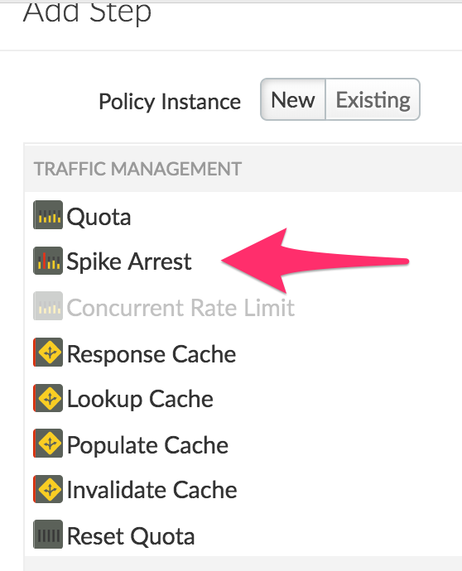
Add a Spike Arrest policy
Start Policy <Rate> @ "2pm"
1 request every 60/2 = 30 secs
In Trace, Send repeatedly to Test for "500" error (validate policy is working)
Reset <Rate> to "200ps"
1 request every 1000/200 = 5 msec

Slide 4
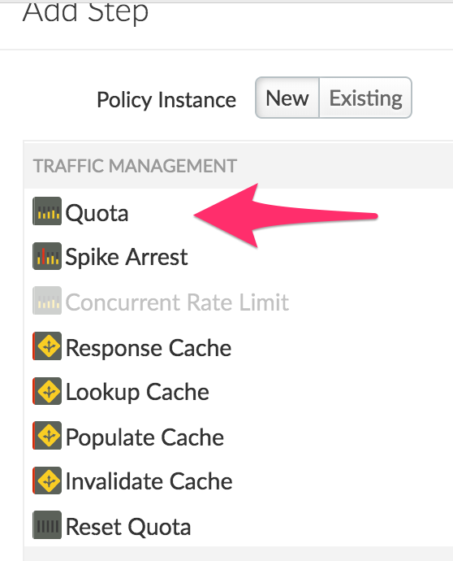
Add a Quota policy
Start Policy @ "2pm"
"Allow" – 2 ; "Interval" = 1; "TimeUnit" = minute
In trace, Test for "500" error code
Reset "Allow" to "50"

Slide 5
Quota Policy - Feed values from the API Product
Find the API Product Quota variable names (in the docs or trace); Test
<?xml version="1.0" encoding="UTF-8" standalone="yes"?>
<Quota async="false" continueOnError="false" enabled="true" name="Quota-1" type="calendar">
<DisplayName>Quota-1</DisplayName>
<Properties/>
<Allow count="2" countRef="verifyapikey.Verify-API-Key-1.apiproduct.developer.quota.limit"/>
<Interval ref="verifyapikey.Verify-API-Key-1.apiproduct.developer.quota.interval">1</Interval>
<TimeUnit ref="verifyapikey.Verify-API-Key-1.apiproduct.developer.quota.timeunit">minute</TimeUnit>
<Distributed>true</Distributed>
<Synchronous>true</Synchronous>
<StartTime>2016-6-1 12:00:00</StartTime>
</Quota>

Slide 6
THANK YOU

